Slide 1

Shiny
Web development through R

Slide 2
Outline
Workshop sessions
Introduction, Structure & Basics - 10th Jan
– Widgets, images, links and how to share
More advanced elements – 17th Jan
– Layout, themes & dashboards, formatting, mapping, plots and tables
Interactivity etc.– 24th Jan
– Troubleshooting & “BYO-App” session

Slide 3

Session 3
Outline
Datatables
Reactivity
Google analytics
Additional resources
App troubleshooting
- BYOA (bring your own app)

Slide 4
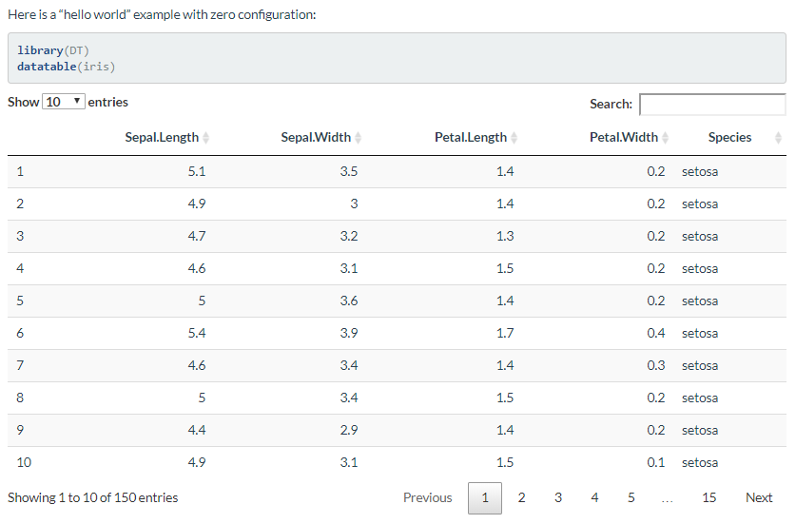
Tables - Datatable
DT: An R interface to the DataTables library
The R package DT provides an R interface to the JavaScript library DataTables
R data objects (matrices or data frames) can be displayed as tables on HTML pages, and DataTables provides filtering, pagination, sorting, and many other features in the tables
You may install the stable version from CRAN, or the development version using devtools::install_github('rstudio/DT')
The main function in this package is datatable(). It creates an HTML widget to display R data objects with DataTables.

Slide 5
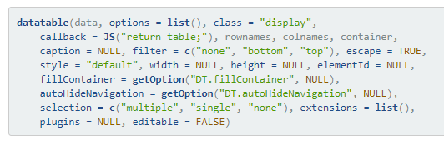
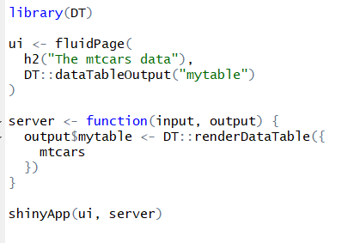
DataTables
minimal example
More complex example:
https://gallery.shinyapps.io/012-datatables/
Demo of other functionalities:
https://rstudio.github.io/DT/
Notes:
With this you need to specify the library you want to call the function from as there are similarly named functions in other libraries.
Hence specifying the library from which we want that function with “DT::”

Slide 6
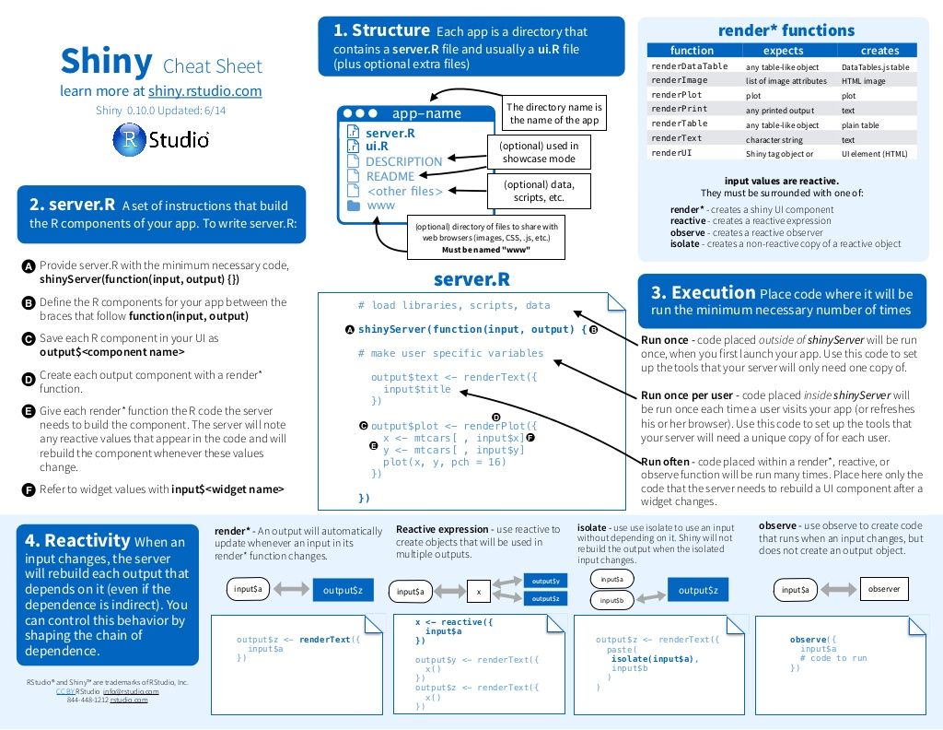
Reactivity
Reactive values act as data streams that flow through your app. They notify items downstream that the value has changed.
E.g. like having an excel formula based on calculation in another cell
You can only call a reactive value from a function that is deigned to work with one (e.g. render*() or reactive() )
Reactive functions (or objects created by reactive functions) respond to this change
Reactive toolkit – 7 ways (4 types);

Slide 7
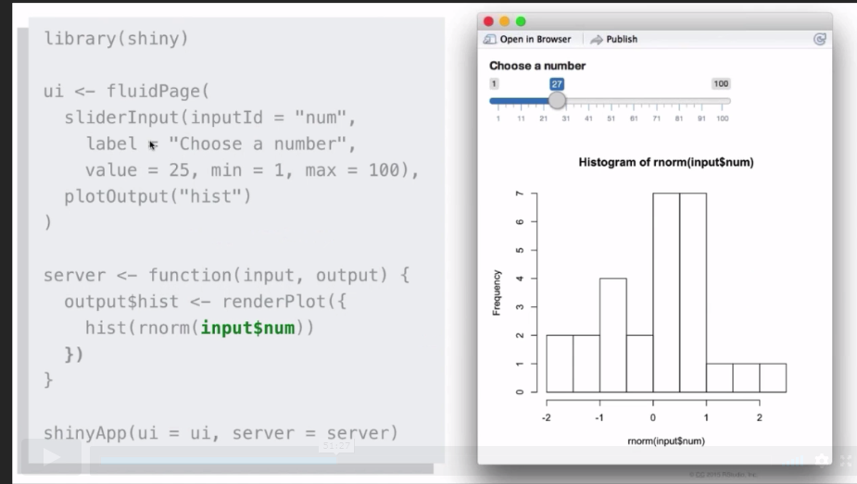
1. render*()
Display output with render*() – i.e. renderPlot ({…})
Save the result to output$
Function will rerun the entire block of code within the curly brackets whenever it is “invalidated”
i.e. whenever the input$ notifies the reactive function that the value has changed.
Notes:
Invalidation – whenever the input$ vale changes it invalidates the downstream dependents i.e. it sends them a notification that this value is now not valid
This triggers the output$/reactive function to rerun it’s code which automatically asks the input for the current (& therefore valid) value.
This is the way we’ve been doing it all along but it just helps to understand the process behind it that makes it interactive/reactive

Slide 8
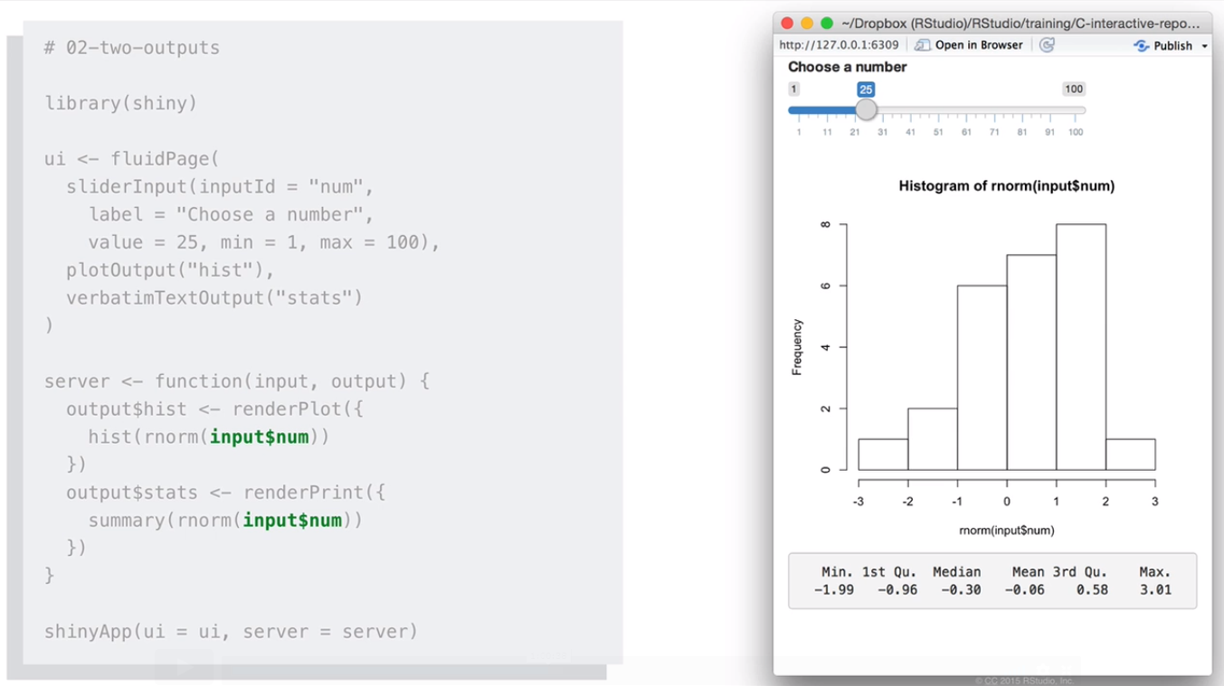
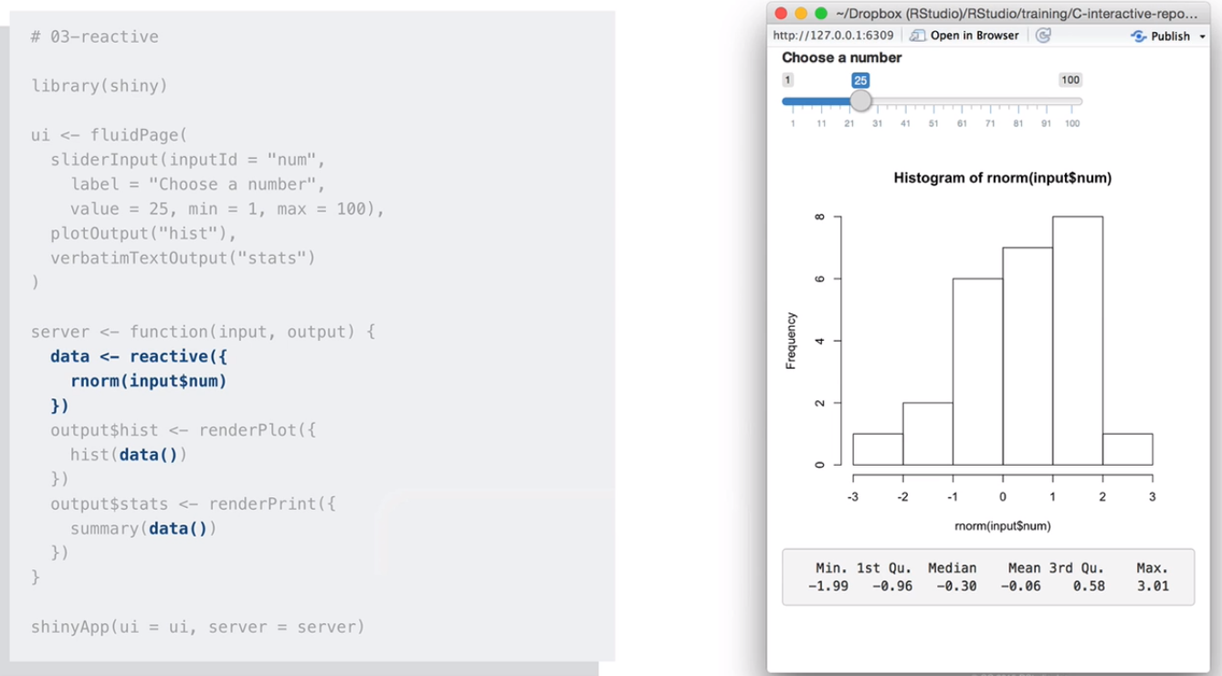
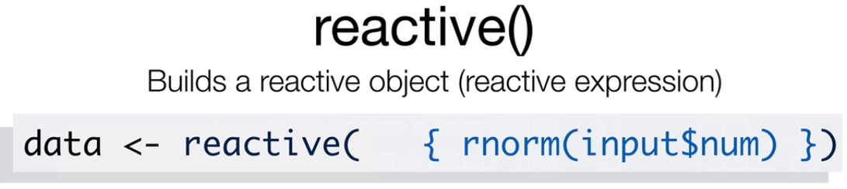
2. reactive()
Modularise code with reactive() – if you want to use the same output in two places
Can build a reactive function/object for use downstream
NB you will have to call this reactive expression like a function (i.e. mydata() )
Reactive expressions cache their values and will return it’s most recent value, without needing to rerun its code, unless it has become invalidated.
Notes:
if you want to use the same output in two places; input will invalidate and notify each of these output objects and each will rerun one after the other.
This isn’t efficient or ideal as each are actually creating it’s own dataset. This is why the second example in the first session was producing two different numbers but the following one wasn’t. the 1-4 example used modularization.
It’s much more efficient due to the reactive expression caching it’s values.
Instead use reactive() to create a dataset as an intermediary step and can then call this and use it downstream. But, this uses an input$ so how do we create a reactive function that isn’t an output$ and isn’t‘ wrapped in a render*()? We use reactive() and we can then call that data downstream. Make an object to use
NB**Can still index components of this data using $ operator but you still must include the open and close parentheses i.e. mydata()$”variablename”

Slide 9
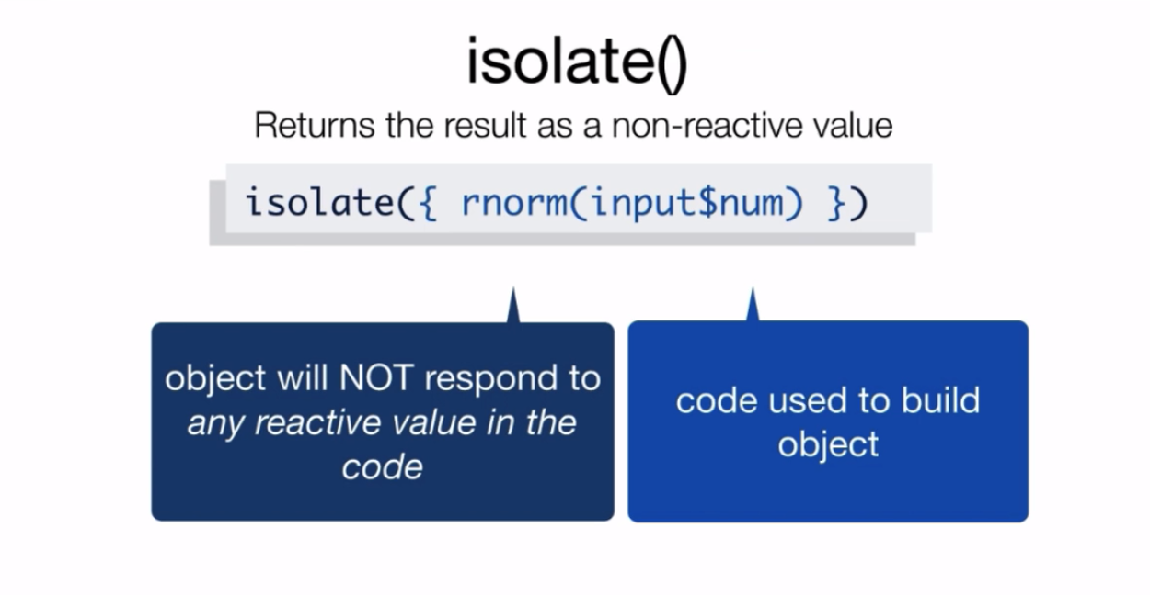
3. isolate()
Use an input$ to generate an output without causing the code to rerun when this input is invalidated/changes
Useful for large datasets or complex computations that you don’t want to rerun over and over
Can treat isolated values as normal R objects
Notes:
You wont need it until you need it – it solves problems you didn’t know you would have
For example if you have an input that changes frequently or that takes a long time to rerun

Slide 10
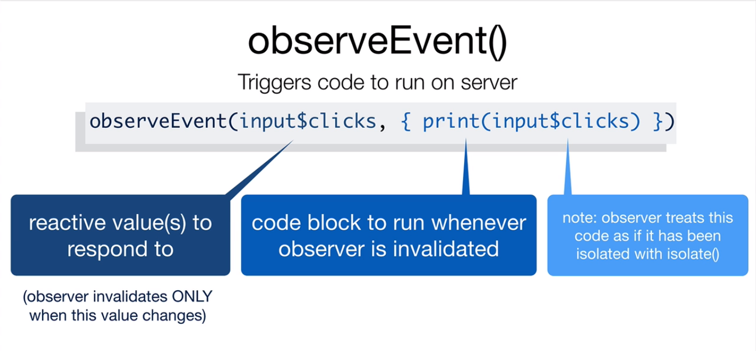
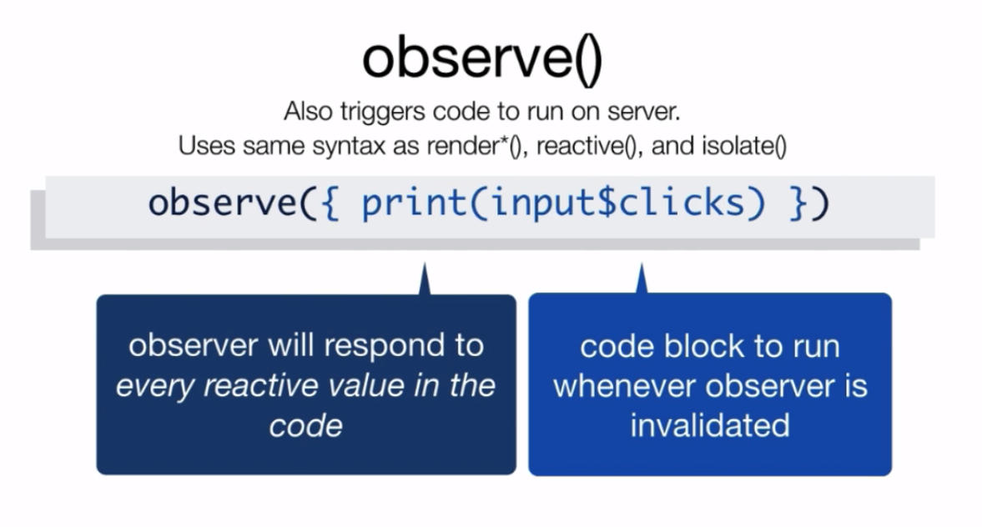
4. Observers
Trigger events with inputs without the need for output$
Create code that runs when an input changes but does not create an output object
Can have a specific input invalidate and rerun or any input
Treats code as if it is wrapped in isolate()
Notes:
Can

Slide 11
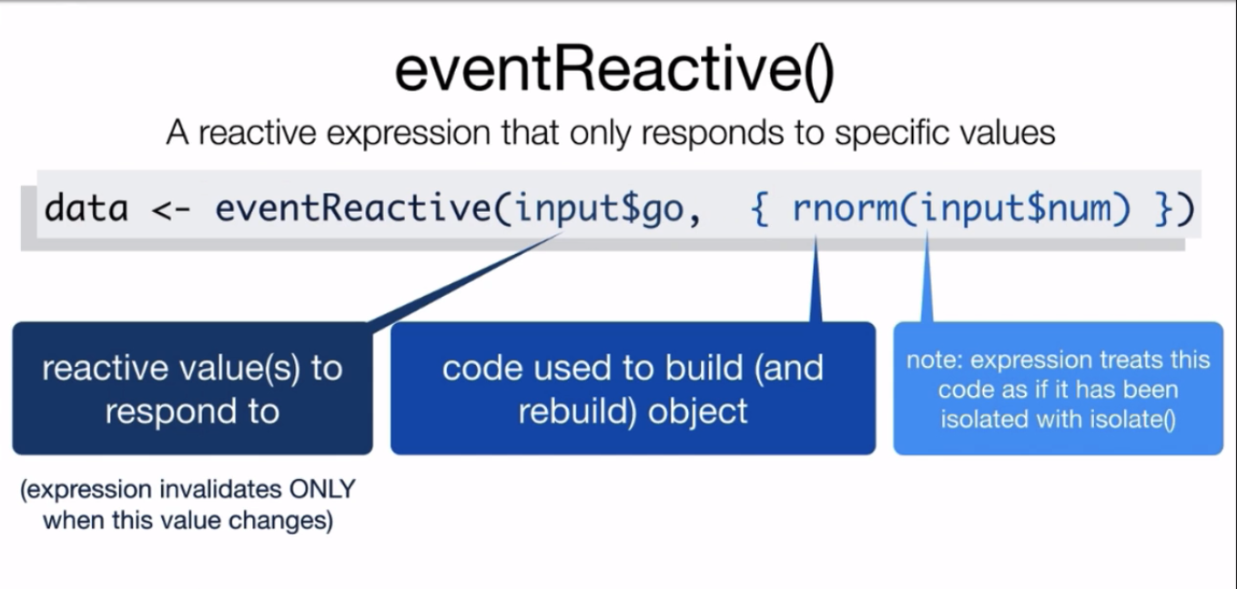
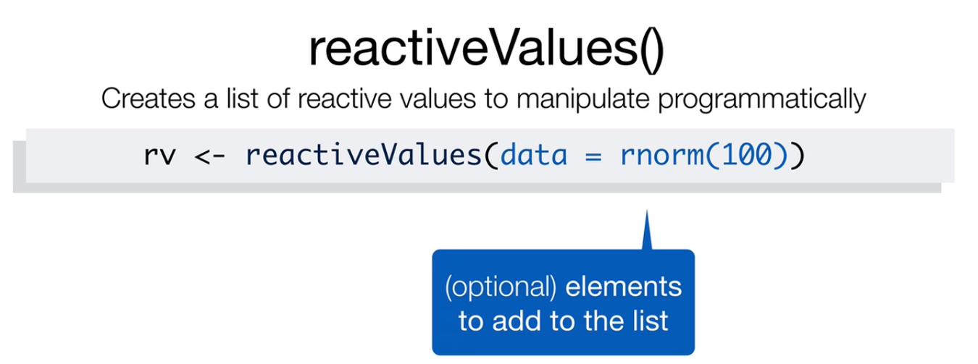
Can delay reactions
Have to call results as a function
Can specify precisely which reactive values should invalidate the expression.
Creates a list of reactive values
You can manipulate these values (usually with observeEvent())

Slide 12
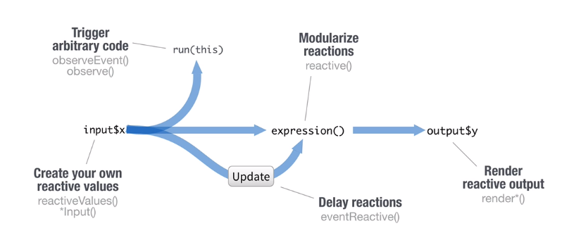
Reactive toolkit

Slide 13
Google analytics
Google Analytics is a free service offered by Google that collects information about who visits you website and what they do while they are there.
You can learn more about Google Analytics at support.google.com/analytics, which explains how to set up and use Google Analytics with a web page.
Informatics Analytics

Slide 14
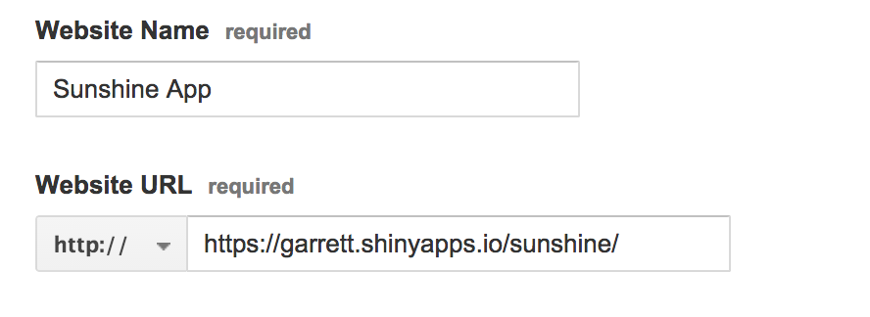
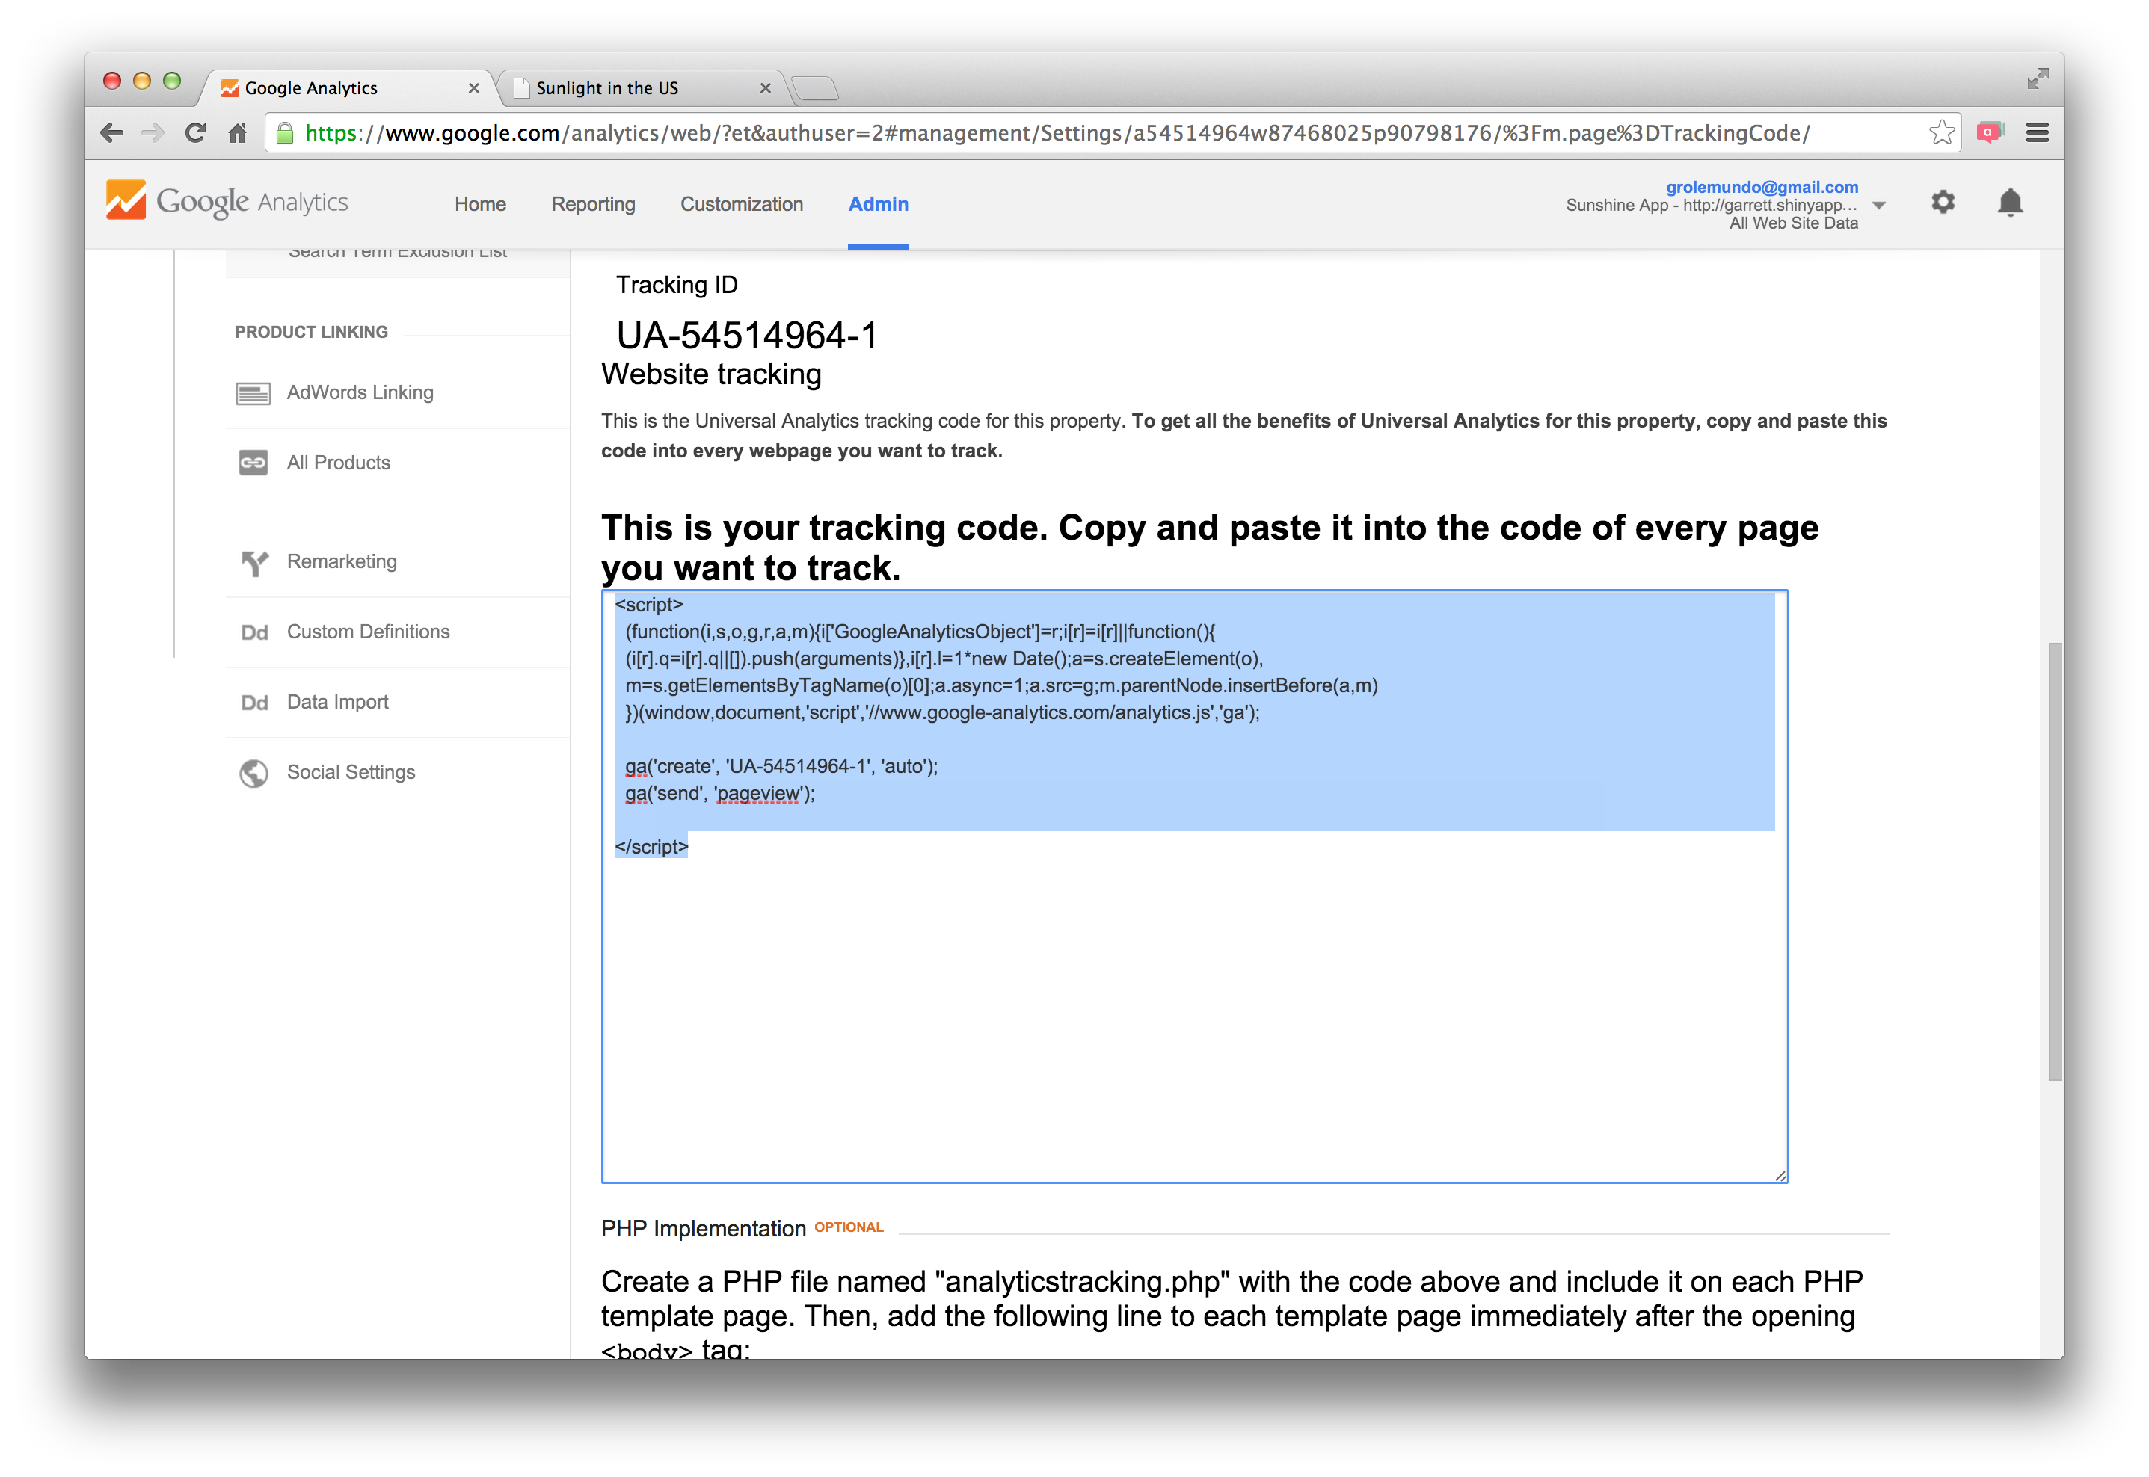
Step 1 - Create an account
To use Google Analytics, you must open a free account at www.google.com/analytics/ .
Step 2 - Add a property
Next, you must register your Shiny app as a property in your Google Analytics account. You can do this on the sign up page, or - if you already have a Google Analytics account-you can do this in the Admin tab.
Once you have entered the necessary information, click “Get Tracking ID” at the bottom of the form. Google Analytics will open a new window that contains a tracking ID number for your app as well as a short JavaScript script.
Step 3 - Embed tracking script
If you built your Shiny app with a ui.R file (the traditional method), use the tags$head and includeScript functions to include the script.

Slide 15
Example
ui <- fluidPage(
tags$head(
includeScript("google-analytics.js")
),
fluidRow(…)
)
File from google analytics

Slide 16
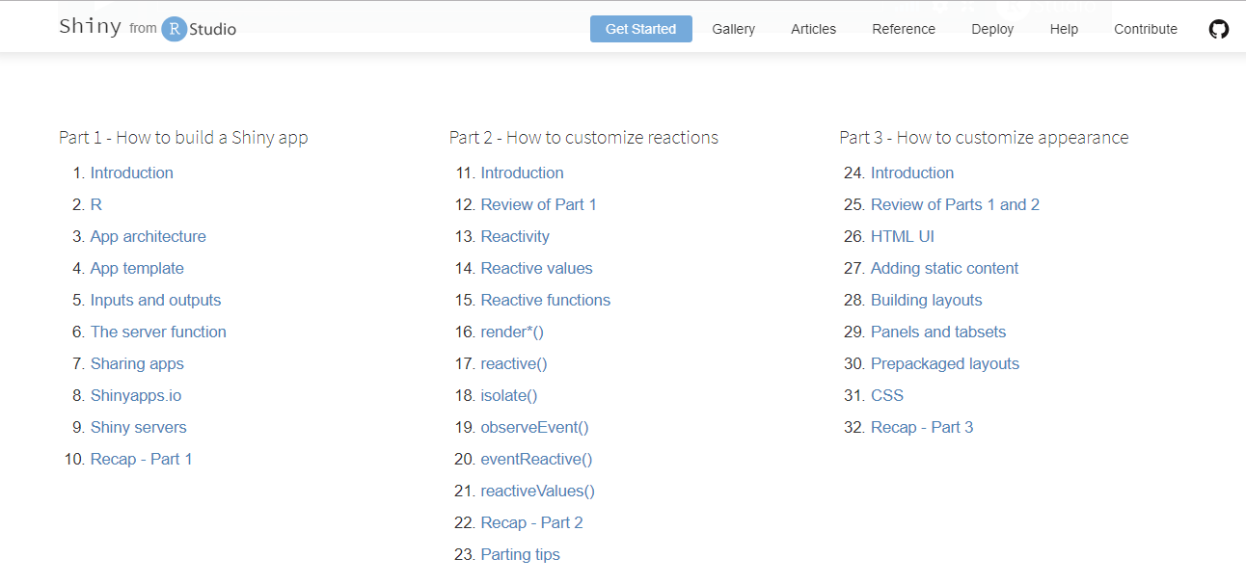
Shiny – Online tutorials
https://shiny.rstudio.com/tutorial/

Slide 17
Other Resources
Datatable https://cran.r-project.org/web/packages/data.table/vignettes/datatable-intro.html
Inspiration & help
http://gallery.htmlwidgets.org/
https://www.r-graph-gallery.com/
https://rstudio.github.io/promises/articles/shiny.html
https://flowingdata.com/category/tutorials/
Flexdashboard https://rmarkdown.rstudio.com/flexdashboard/
D3
https://github.com/d3/d3/wiki/Gallery
http://myinspirationinformation.com/visualisation/d3-js/integrating-d3-js-into-r-shiny/
Spatial – mapping in R http://spatial.ly/r/

Slide 18

Questions?

